Slide 2
tangent galvanometer

Slide 11
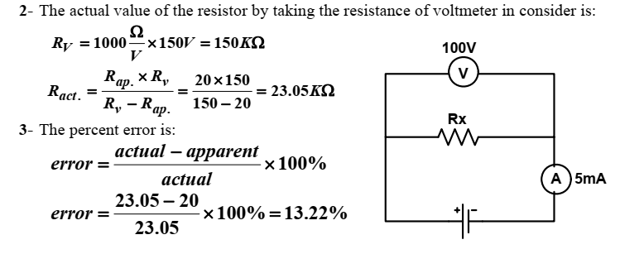

Slide 30
bridge

